Slide 1
Flight Planning: A Discussion
Don Heidrich
17 September 2002

Slide 2
Basic
Scheduler
  Got the Right Plane?
Squawks
  On-Line
  In Aircraft

Slide 3
Weather
TWC
  Big Picture
Window
  Local Picture
Radar & Surface Analysis
  Current and Forecast
AOPA Briefing
  Specifics and NOTAMs

Slide 4
Weight and Balance
“Standard” Scenario
  4 x 172 Lbs
  48 Gallons = Full Fuel
  No Baggage
  Max Useful Load 975 Lbs
If Close, Do the Math!

Slide 5
Fuel Planning
48 Gallons Max
10.5 GPH
4 Hours VFR
3 ½ Hours IFR
Tank Management
  30 Minutes then alt 60 Minutes

Slide 6
Go/No Go
Thunderstorms
  Stay Well Clear
  If Embedded, No Go
  Storm Scope Provides Margin
Icing
  Always Forecast
  Need Clear or Warm Level Available
  Consider Plan B on First Sign

Slide 7
Personal Minimums
Wind
  20 Knots – Pay Attention
  25 Knots – Probably NO
Ceiling
  Near IFR Minimums
  Need Plan B
    Not Too Far
    Good Ceiling – 1000 Feet?
    Easy Approach
    Big Airport

Slide 8
Checklist
ARCHER N38483
BEFORE START
External Preflight Complete
Passenger Briefing Complete
VOR Accuracy Current
Start Tach Time Log
Seats, Belts, Harnesses Secure
Door and Window Closed/Locked
STARTING
Breakers Check
Electrical Switches Off
Fuel Selector Lower Tank
Brakes Test and Set
Throttle Open 1/4"
Master On
Fuel Pump On
Fuel Pressure Check
Mixture Full Rich
Carburator Heat Cold
Prime As Required
Propeller Area Clear
Starter Engage
Oil Pressure Check
Beacon On
Fuel Pump Off
RUN-UP
Parking Brake Set
Fuel Selector Fuller Tank
Controls Free
Throttle 2000 RPM
Engine Instruments Check
Ammeter Check
Vacuum 4.9-5.1"
Fuel Pressure Check
Magnetos 175/50 RPM
Carburator Heat On & Check
Throttle Idle
Carburator Heat Off
Altimeter & DG Heading Set
Comm, VOR, ADF, Marker Set
Annuciator Panel Test
Trim T/O Setting
Flaps 0° - 25°

Slide 9
Checklist
BEFORE TAKE-OFF
Seats, Belts, Harnesses Secure
Door and Window Closed/Locked
Fuel Selector Fuller Tank
Trim T/O Setting
Flaps 0° - 25°
Electric Trim Off
Auto Pilot Off
Mixture Full Rich
Carburator Heat Off
Fuel Pump On
External Lights On
Time Note
Transponder On/Alt.
SPECIFICATIONS (KIAS)
Vs0 47
Vs1 58
Vr 41-65 (55)
Vx 64
Vy 76
Best Glide 76
Vfe 102
Va 113-89
Vno 125
Vne 154
APPROACH
Downwind 90
Base 80
Final 75 - 66
75% Cruise: 2500' / 2500 RPM
TAS 115
Fuel 10.5 gal/hr
WEIGHT
Max Usable Fuel 48 gal (38 to Tabs)
Max Gross Weight 2550 lbs
Max Useful Load 975 lbs
(4 x 172 lbs plus full fuel = 975)
Max Baggage 200 lbs
POWER vs PERFORMANCE (clean)
KIAS RPM VSI
115 2500 0
115 2200 -500
90 2100 0
90 1700 -500

Slide 10
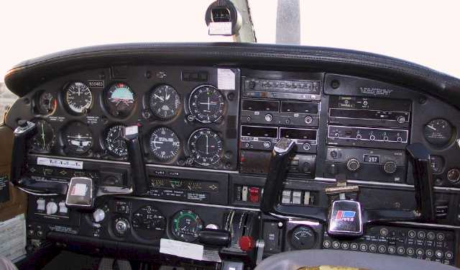
Panel Check

Slide 11
Taxi Panel Check
Whisky Compass
  Full of Fluid
  Swinging Freely
  Indicating Proper Direction
Airspeed
  Zero
Horizon
  Erect in 5 Minutes
  Follow Turns 3 Degrees
Altimeter
  Field Elevation

Slide 12
Taxi Panel Check
Turn Coordinator
  Follow Turns
  Ball Outside
  No Flags
DG
  Follow Turns
  Indicate Proper Direction
Rate-of-Climb
  Zero
  If Not So Note

Slide 13
FIN

